Slide 1

Digital
Marketing Analysis with DAX

Slide 2
Problem Statement
As a Data Analyst at a Digital Marketing Agency, the primary objective is to optimize the performance of advertising campaigns across various platforms to achieve maximum return on investment (ROI) for clients.
To accomplish this, we have access to multiple datasets containing features related to ad campaigns, impressions, clicks, conversions, sales, and advertising budgets.

Slide 3
Analysis Objectives:
Campaign Performance Analysis: Evaluate the performance of each ad campaign by analyzing metrics such as impressions, clicks, conversions, and ROI across different platforms and ad formats.
Platform Comparison: Compare the performance of advertising campaigns across different platforms to identify the most effective platforms in terms of cost efficiency and conversion rates.
Optimization of Ad Formats: Determine the effectiveness of different ad formats (e.g., display ads, skippable ads) and optimize their usage to maximize user engagement and conversion rates.
Budget Allocation Optimization: Optimize the allocation of advertising budgets across campaigns, platforms, and ad formats to achieve the highest possible ROI while meeting sales targets.

Slide 4
Analysis Objectives:
Temporal Analysis: Identify temporal patterns and seasonality trends in ad performance to optimize campaign scheduling and budget allocation throughout the year.
User Engagement Analysis: Analyze user engagement metrics such as average pages visited and average time on site to understand the quality of traffic driven by advertising campaigns and optimize targeting strategies accordingly.
Cost Efficiency Analysis: Evaluate the cost efficiency of advertising campaigns by analyzing metrics such as CPM and CPC, identifying opportunities to reduce costs while maintaining or improving campaign performance.

Slide 5
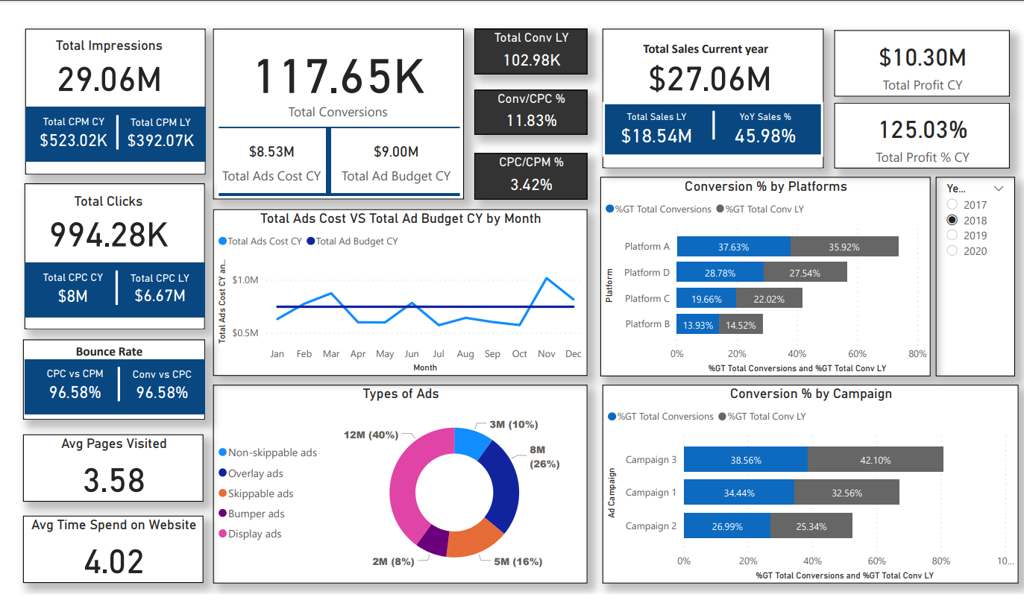
Marketing Analysis

Slide 6
Marketing Analysis Insights
Total conversions are significantly higher than total sales revenue. This is likely because the average conversion rate is higher than the average order value. In other words, more people are converting on the ads than are making a purchase. This could be due to a number of factors, such as the ads being effective at generating interest but not necessarily at driving sales, or the products or services being sold being expensive or complex.
The cost per click (CPC) is lower than the cost per mille (CPM). This means that it is cheaper to get someone to click on an ad than it is to show them the ad 1,000 times. This is a good sign, as it means that the ads are being targeted to the right people and that they are effective at generating clicks.
The conversion rate is highest for platform A. This means that platform A is the most effective at driving conversions. This could be due to a number of factors, such as the platform's targeting capabilities, the creative of the ads, or the placement of the ads.
The bounce rate is highest in January and December. This means that more people are leaving the website without converting in these months. This could be due to a number of factors, such as the seasonality of the business, the quality of the website, or the relevance of the ads.
The average time spent on website is highest for campaign 2. This means that people are more engaged with the content on campaign 2. This could be due to a number of factors, such as the quality of the content, the relevance of the content to the target audience, or the length of the content.

Slide 7
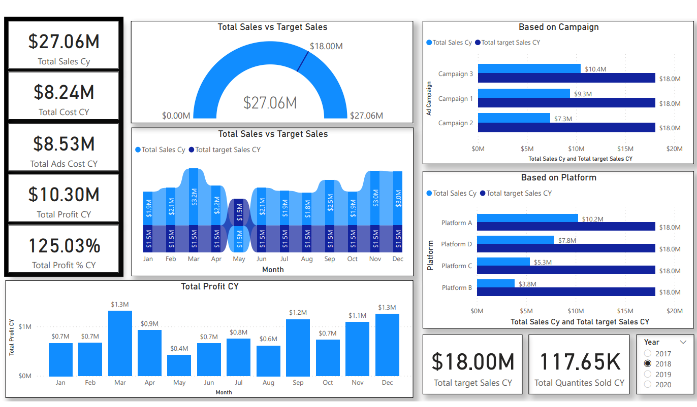
Sales Analysis

Slide 8
Sales Insights
Overall sales are above target. Total sales for the year were $27.06 million, which is 150.3% of the target of $18 million.
Sales are up year-over-year. Total sales in 2020 were $27.06 million, compared to $18 million in 2019. This is an increase of 50.4%.
Campaign 3 is the top-performing campaign. Campaign 3 had sales of $10.4 million, which is 38.8% of total sales. It also exceeded its target of $9.3 million by 118%.
Platform A is the top-performing platform. Platform A had sales of $10.2 million, which is 37.7% of total sales. It also exceeded its target of $18 million by 46.7%.
Profit is also up year-over-year. Total profit for the year was $50.7 million, compared to $117.65 thousand in 2019. This is an increase of 42,978.4%.

Slide 9
Thank You!

